Slide 1


Alpha Phi Omega
Chi Chapter at UCLA
Alpha Kappa / David A. Emery Term, Meeting 6
November 13, 2013
www.apo-x.org

Slide 2
Agenda
1. Officer Updates and Announcements
2. Chapter Business
a. Mid-Chapter Evaluations
b. Advisor Nomination/Election
c. Regional Voting Delegate Nominations?
3. Last Announcements

Slide 3
President
Holly Fuong
president@apo-x.org
Executive Committee
excomm@apo-x.org

Slide 4
[L] LAUNCH
Tuesday 11/19 @ 6pm
Sunday 12/8 @ 1pm

Slide 5
Upcoming Workshops
Need more workshops?!?
Consider hosting one! Yay!
If not, look forward to:
- Constitution Day
- Parli Pro
(Coming in January)

Slide 6
Typhoon Haiyan
•2,275 is the current death toll
•11 million affected
•19 tropical storms hit the Philippines per year

Slide 7
Biggest need? Clean water.
Littles are expensive, trust me I know (what up NatalieJustinAndrew).....
$1
The check will be made out to UNICEF.
$27 = 7 families a month’s supply of clean water
$58 = 15 people with essential hygiene supplies
$88 = evacuation center for 35 kids

Slide 8
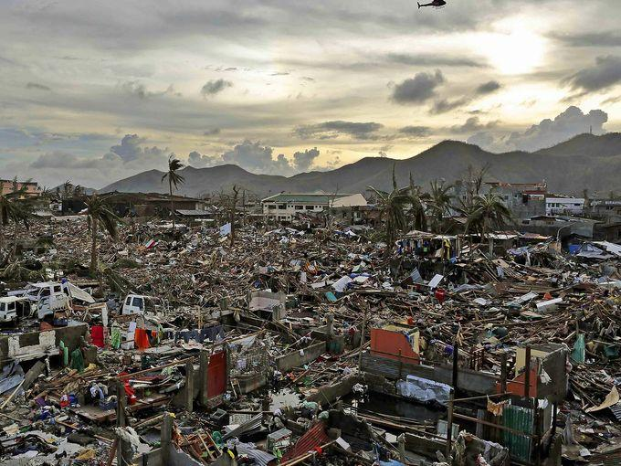
Please help.
• Tacloban City
• 14 Chapters of Alpha Phi Omega in Tacloban City

Slide 9
Last stuff
No fundraising goal, just want to give as much as we can give.
Special thanks – Holly. :)
Will keep collecting until the end of next week.
From the bottom of my heart, maraming salamat. (Thank you). <3

Slide 10
Administrative VPs
Jacqueline Pan & Melanie Teepronpirut
admin@apo-x.org

Slide 11
Have a great week!
No updates (:

Slide 12
Membership VP
Vivian Kwan
membership@apo-x.org

Slide 13

Sign up!
Lots of fam events on calendar! ACTIVE BONDING DAY! 11/24 YAYYYY

Slide 14
Achievement 2:
3 bad standing, 2 alumni, 1 good standing active
make a 3,2,1 human pyramid in front of the building where Chi Chapter was rechartered and take a picture! (

Slide 15

Ski Trip
Sign ups will open immediately after toast song tonight!!
People who sign up will have priority for 24hrs. After that, it’s whoever can pay me first!

Slide 17
Service VPs
Kevin Qiu & Gabrielle Taylor
service@apo-x.org

Slide 18
Sign Up for Service!
Sunday, 11/17:
Walk to Feed the Hungry, 8 am - 12pm
Help an APO brother & work with the University Buddhist Association
Saturday 11/30:
Homeless Feeding & Banner Creation,
6:30am - 7:00 pm

Slide 19
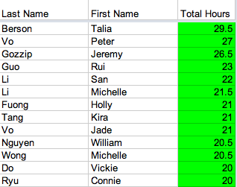
Service Scoreboard:
Great Job to all the Actives who have finished their 20 hours!

Slide 20

Dance Marathon 2014
April 5-6, 2014
Interested in an APO team?

Slide 21
Pledge Parents
Hamilton Luu & David Yuan
pledgeparents@apo-x.org

Slide 22
10 Actives/Rest of Pledge Class
Founding Fathers and Types of Service
Midnight Mission
Big/Lil Mission

Slide 23
Those who paid their good-standing dues on time are considered “required actives”
If you’d like to take yourself off/put yourself on the list, let us know.

Slide 24
Finance VPs
Alejandra Chavez & Raymond Mai
finance@apo-x.org

Slide 25
Financial Management
Pay Me

Slide 26
Fundraisers
- Bake Sale
-Spam Masubi
-Tamales for Sale
-TV Tapings

Slide 28
Fellowship VPs
Jessica Cui & Kevin Quizon
fellowship@apo-x.org

Slide 29
LGN
PAYY USSS $___$ BY TODAY. Thanks!
Late fee of 5 dollars per day.

Slide 30
LGN Talent Show
Thank you for the brothers who signed up for Talent Show!
If you still want to sign up.. come talk to us! and we shall arrange something (:

Slide 31
Vegetarian?
COME TALK TO US. We will be arranging the vegetarian options.
Don’t worry (:

Slide 32
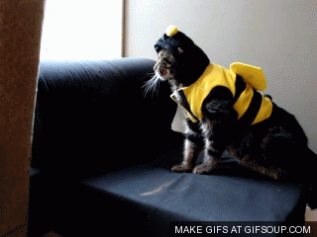
Secret Brother
Please turn in your gifts for this week!
Task for CM8: Give your secret brother something that will remind them of home!

Slide 33
Historian
Selena Saenz
historian@apo-x.org

Slide 34
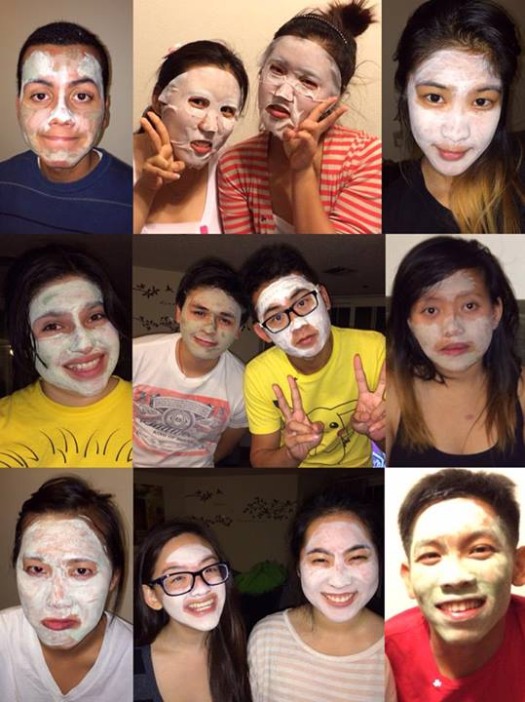
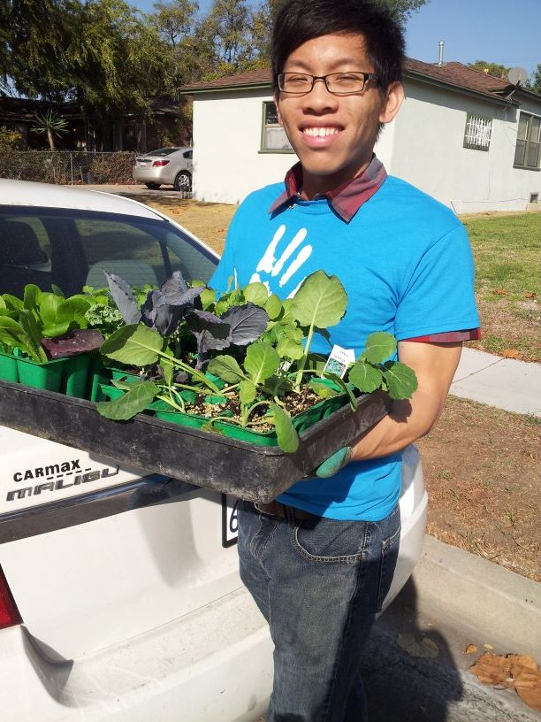
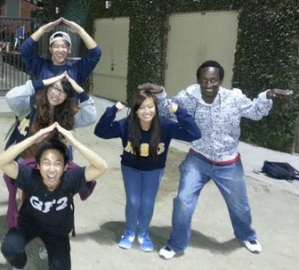
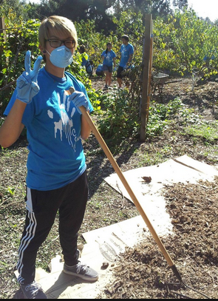
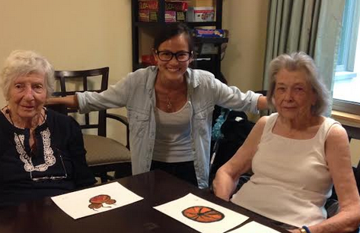
Photos of the Week!

Slide 35
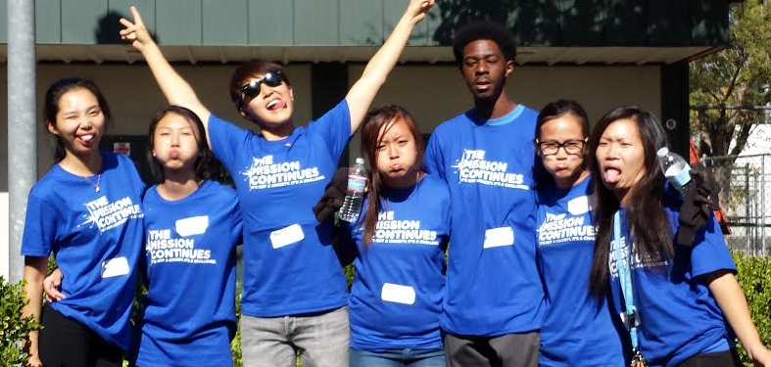
Top Hit of the Week!

Slide 36
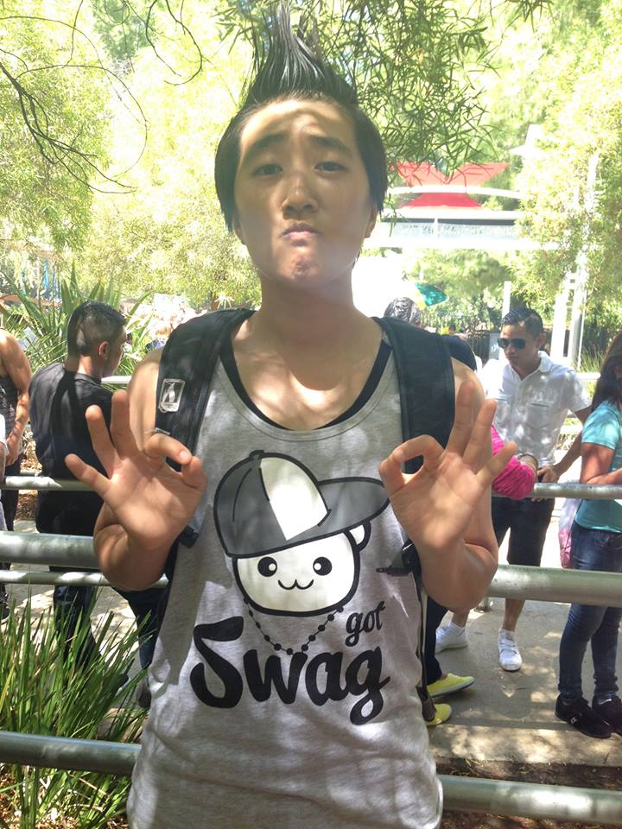
Yuna Choi

Slide 37

Trivia Time!

Slide 38
Trivia Time!
a. The remainder of the Transportation costs for the voting delegates shall be paid for Nationals.
b. ½ of the Registration fees for the non-voting delegates shall be paid for Nationals.
c. The remainder of the Registration costs for the non-voting delegates shall be paid for Nationals.
d. ½ of the Transportation costs for the non-voting delegates shall be paid for Nationals.
f. ½ of the Transportation costs for the voting delegates shall be paid for Nationals.

Slide 39
Sergeant-at-Arms
Maria Valenzuela
saa@apo-x.org

Slide 40
Evaluating
Please remember chairing guidelines.
When evaluating please attach a picture!
Also, any discrepancies on chairing please email me.

Slide 41

This weeks A.B.E.A

Slide 42
Juana Li[4H] Veteran's Day Service, 11/09/13
We were short with rides for one person and since Yuna flaked in, she was able to drive to the event. We all met up at Hedrick Summit and drove to the elementary school. Then we signed in and got our free t-shirts. When we were waiting for everyone else to sign in, someone asked us if we could walk down the street and guide people to the event entrance, but she told us to come back no later than ten minutes. It took around 5 minutes just to walk there and then we had to walk back after 2-3 minutes, so that wasn't all that exciting. When we got back, we were split up into teams and we had to weed, lay tarp, and put mulch on top of the tarp. We were beautifying one part of the school where they had a lot of plants and trees. It was kind of hard because we didn't know if some things were weeds or not. LOL Laying the Tarp was especially difficult cause we had to cut the tarp for the trees and we had to go around all the plants. Judy layed out the tarp, Yuna would hold the branches, Angie and I would do the slits and stake it down, and Vicki, Ariel, and Abram applied the mulch and fixed the tarp. One time, Ariel got really close to a bush and someone let go of it, and it whacked her in the face. It was pretty funny, and she was okay though. And we also ran out of mulch in the end and Abram and Vicki walked all the way to bring bags to our gardening spot. Then after the teams finished mulching, they got to paint, but ours took the longest so we didn't get to paint. But, Ariel got to cut some of the bushes and she we was so excited too, while we were all tired in the end. The service was really fun and before we left, we were given challenge coins. It's a coin that presents achieving something and giving back to the community. It was a really nice silver coin that came in this plastic case and in a nice velvet baggy. This was a really good service event and we got to work with veterans! I think that more people should come next time and try to eat something before you come because we got really hungry and they were running out of snacks.

Slide 43
Interchapter Chair
Olivia Pardo
interchapter@apo-x.org

Slide 44

“Let the Memories Begin!”
January 18th - 19th, 2014
University of California, Santa Cruz
Until 12/1: $70 without Banquet / $80 with Banquet
12/2-1/10: $80 without Banquet / $90 with Banquet
www.RegionalsX2014.squarespace.com
agn.apo.regionals@gmail.com

Slide 45
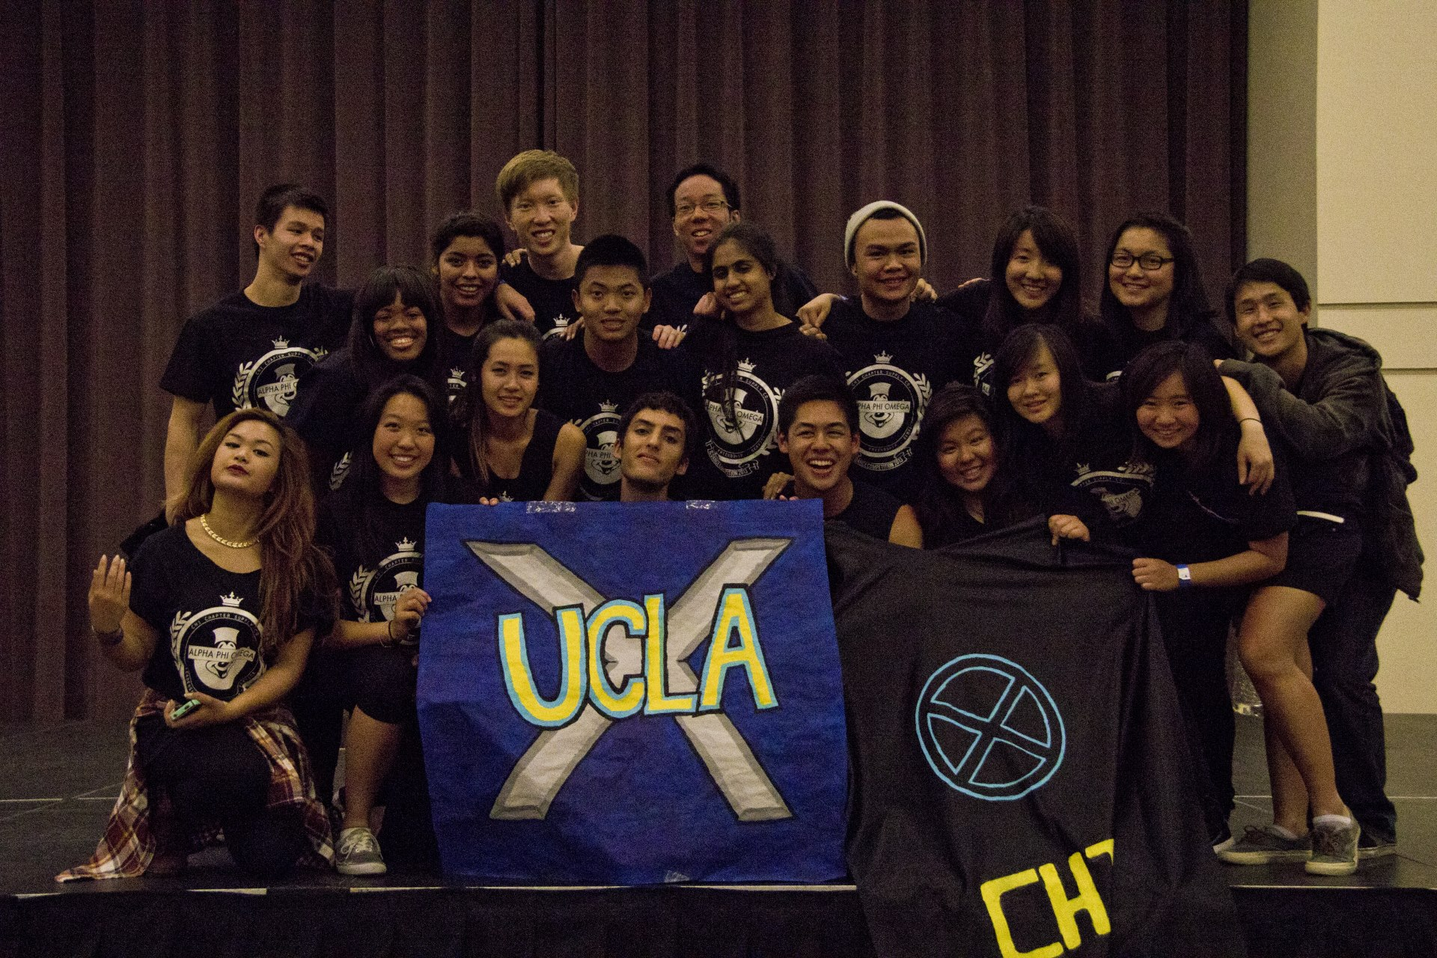
ICDC
SAY WHAAAT?! THAT’S RIGHTTTT.
Workshop with Althea!
Date TBD

Slide 46
Chair of the
Advisory Committee
Tristan Darvin
cac@apo-x.org

Slide 47
CAC Office Hours
- Friday, By Appointment
- Somewhere in Westwood
- (760) 218-1479
- apoxcac@gmail.com

Slide 48
Words of Wisdom
“The challenge of Leadership is to be strong, but not rude; be kind, but not weak; be bold, but not bully; be thoughtful, but not lazy; be humble, but not timid; be proud, but not arrogant; have humor, but without folly.”

Slide 49
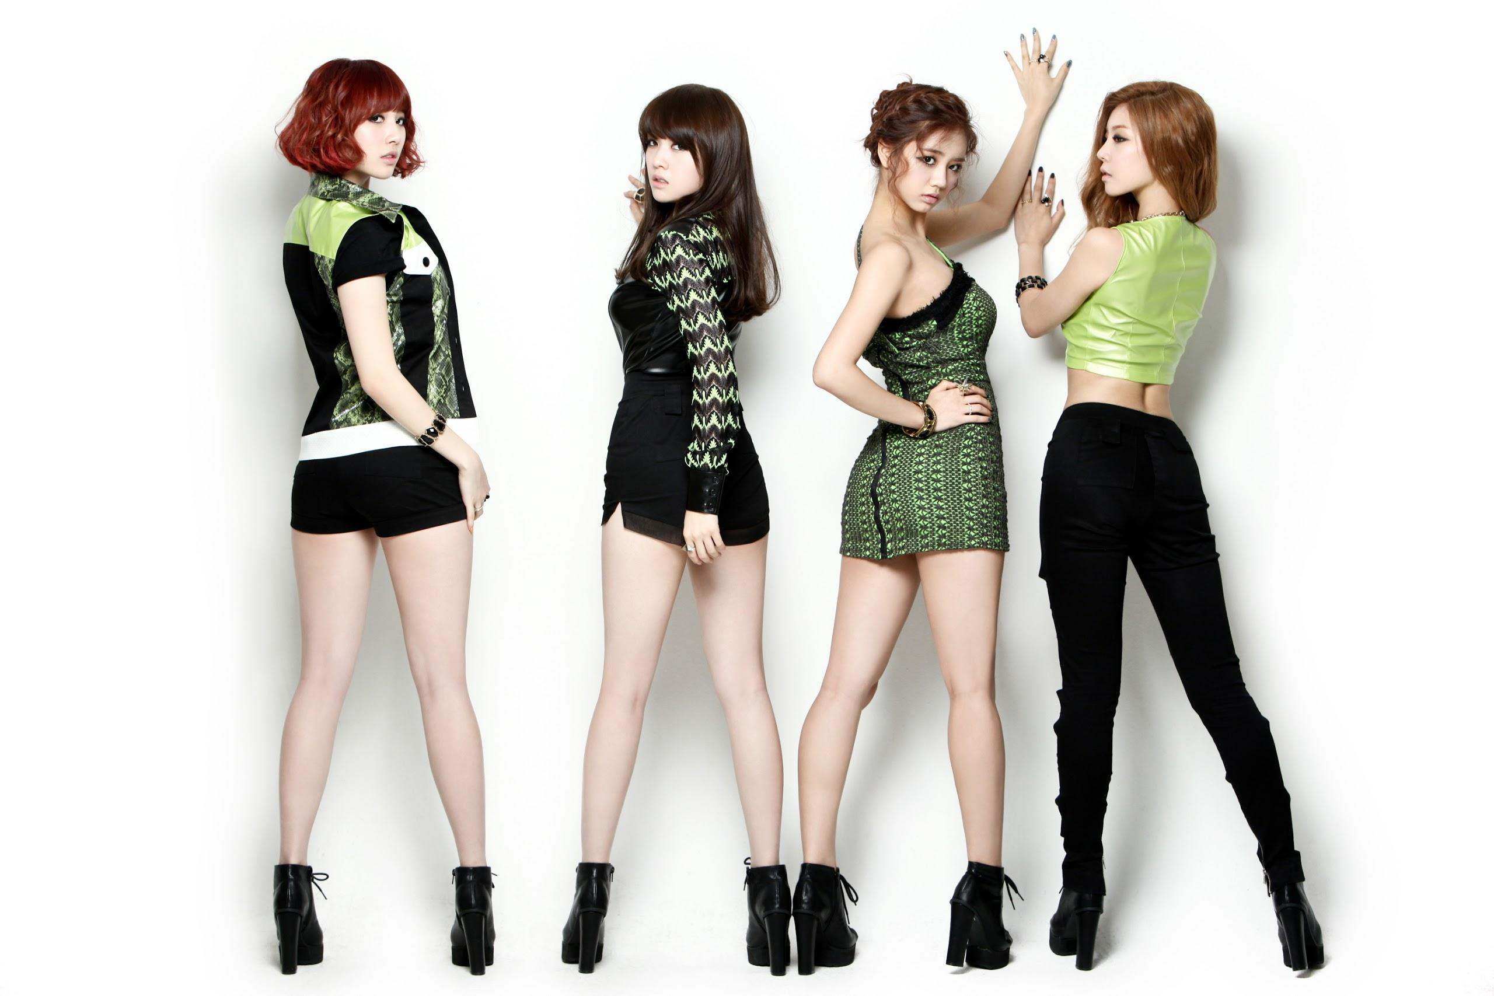
CAC Updates
Good luck with everything Chi Chapter!

Slide 50
Chapter Business

Slide 51
Advisor Nomination/Election
- Kevin Lee

Slide 52
Regionals Voting Delegate Nominations

Slide 53
Mid-Chapter Evaluations
Alpha Kappa 2013

Slide 55
Pledges out of 45 responses
Pledge requirements that should be changed are?
Dues: 3 + / 14 -
Interviews: 1 + /31 -
Service Hours: 6 + / 8 -
Fellowship: 12 + / 2 -
Flaking/late policy: 3 + / 10 -
Chairing Policy 3 + / - 9
Family events 14 + / - 1
Family Competitions 11 + / - 1
Fundraisers 6 + / - 11
Interchapter 9 + / - 3
PAC Social 15 + / - 3

Slide 56
Pledges out of 45 responses
Pledge requirements that should be changed are?
LEADS workshop 3 + / - 8
PAC philanthropy 6 + / - 5
Active interview 1 + / - 19
strike policy 11 + / - 11

Slide 57
Pledges out of 45 responses
How Long should a chapter meeting take ideally?
30-45 minutes → 3
1 hour → 30
1.5 hours → 8
As long as it needs to be (to take care of our chapter business) → 7

Slide 58
Pledges out of 45 responses
I like having family games during chapter meetings
YES → 43
NO → 4
Do you think Brother of the Week, and ABEA presentation is a good idea?
YES → 43
No → 0

Slide 59
Pledges out of 45 responses
I pledged APO because…
I <3 leadership → 21
I <3 service → 36
I believe in the cardinal principles of LFS
My friends are here → 19
I love the people I meet → 44
Something new → 33
Peer pressure → 4
I have a lot of fun → 32
I don’t know → 2

Slide 60
Pledges out of 45 responses
Issues I see in APO are...
Too many cliques → 12
lack of brotherhood → 1
not fun → 0
Too rule-based → 5
havent bonded with anyone → 1
too many requirements → 26
too time-consuming → 32

Slide 61
Pledges out of 45 responses
Which events do you want to see more on calendar?
Fam events → 25
Fam comps → 13
Service → 20
fundraisers → 19
fellowships → 23
IC → 13
Leadership workshops → 14
Alumni Events → 13

Slide 62
Pledges
How can we improve on the issues above? what do you want to see changed in APO? What is your remedy?
more bonding acitivites prior to campout
more mixed events instead of just fam/pac/…. Events. Like it when we are all mixed => get to converse with everybody
1 page of writing up is a lot, I miss sleep
I just wish we had a bit more time to complete requirements. Also, more actives should be out at kerckhoff and and if they aren't doing interviews, they shouldn't mingle because it's kind of disheartening when you go up to one for an interview and they're like "im not doing interviews. I'm going to leave in 5 minutes" and then they stay and chat with their friends for another half an hour :(

Slide 63
Pledges
How can we improve on the issues above? what do you want to see changed in APO? What is your remedy?
I wish the requirements were less time consuming because I have a good time management and my grades/sleep are still getting worse
faster meetings
interviews are definitely time consuming but I get why it's required. Half page interviews help (:
shorter meetings during midterm weeks
interviews are really time consuming, they should just be signature based. Pin strikes also seem like a lot. 1/2 strikes for pins is more reasonable. As well as half on quizzes
more group acitivites to everyone has to participate, not family games where only loud outgoing people can join
it's only because interviews take a lot of time. So maybe less interviews required

Slide 64
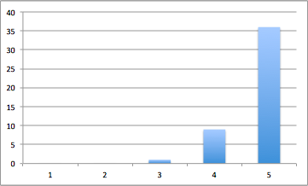
Pledges
President
Average: 4.76

Slide 65
Pledges
President
shorter meetings!
woo Holly!
Be more available
meh it’s OK

Slide 66
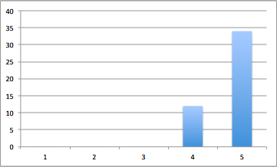
Pledges
Admin VPs
Average: 4.74

Slide 67
Pledges
Admin VPs
less cluttered website
my pw link on the website does not work :(
keep website updated

Slide 68
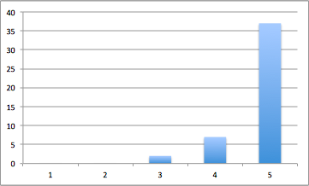
Pledges
Membership VP
Average: 4.76

Slide 69
Pledges
Membership VP
Keep going!
Better retention

Slide 70
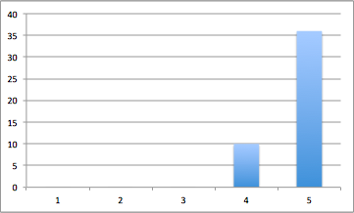
Pledges
Service VPs
Average: 4.78

Slide 71
Pledges
Service VPs
Put Meals on Wheels back on calendar please
more variety

Slide 72
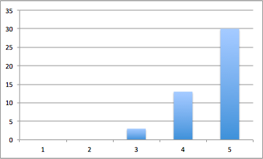
Pledges
Pledge Parents
Average: 4.59

Slide 73
Pledges
Pledge Parents
need more guidance/direction with requirements
more even PAC groups
they’re awesome
David needs to talk more during meeting
be more informative, sometimes a lot of pledges don’t know what’s going on
have make up strikes, let us know about stuff earlier
keep interview doc up to date sooner
be more strict, organized and authoritative
Dads are great
more information updates, more structure in requirements tracking
more equal presence on both PPs, David does not do a lot and is not very serious

Slide 74
Pledges
Finance VPs
Average: 4.78

Slide 75
Pledges
Finance VPs
MACKMAI
more fundraising events
TP Tapings on Saturdays
Raymond is awesome

Slide 76
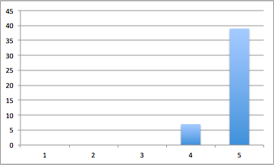
Pledges
Fellowship VPs
Average: 4.85

Slide 77
Pledges
Fellowship VPs
better numbers, weekend exceptions

Slide 78
Pledges
Historian
Average: 4.83

Slide 79
Pledges
Historian
I love BOTW
Pledge of the week needs to be changed
maybe photo album online?

Slide 80
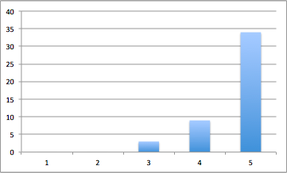
Pledges
Sergeant-At-Arms
Average: 4.67

Slide 81
Pledges
Sergeant-At-Arms
restricts too much
intimidating
enforce KISS more
less KISSing

Slide 82
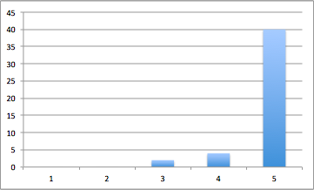
Pledges
Interchapter Chair
Average: 4.83

Slide 83
Pledges
Interchapter Chair
I love her enthusiasm, and there are a lot of IC events!
I like how you are super loud
more IC events
GO EAST COAST
go more places

Slide 84
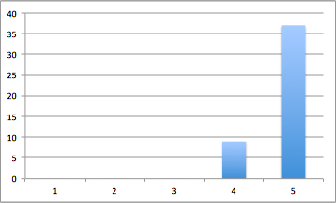
Pledges
CAC
Average: 4.80

Slide 85
Pledges
CAC
less formality
very informative, actually like it
Go Tristan
Tristan’s great

Slide 86
Pledges
Additional comments for Excomm?
More fellowships
six flags, disneyland, karaoke, boba
bring back dinner for 10

Slide 87
Pledges
Additional comments for PPs?

Slide 89
Pledges out of 69 responses
Active requirements that should be changed are?
Dues: 1 + / 20 -
Interviews: 5 + /5 -
Service Hours: 11 + / 3 -
Fellowship: 9 + / 4 -
Flaking/late policy: 1 + / 4 -
Chairing Policy 1 + / - 12
Family events 11 + / - 3
Fundraisers 7 + / - 14
Interchapter 5 + / - 5
Leadership 9 + / - 8
Chapter meeting attendance 5 + / - 11
Committee 3 + / - 5

Slide 90
Actives out of 69 responses
Should Chi chapter have active requirements?
YES → 57
NO → 9

Slide 91
Actives out of 69 responses
How Long should a chapter meeting take ideally?
30-45 minutes → 8
1 hour → 35
1.5 hours → 14
As long as it needs to be (to take care of our chapter business) → 12

Slide 92
Actives out of 69 responses
I like having family games during chapter meetings
YES → 52
NO → 7
Maybe → 10

Slide 93
Pledges out of 45 responses
I pledged APO because…
I <3 leadership → 25
I <3 service → 49
I believe in the cardinal principles of LFS → 32
My big is still here → 27
My little(s) is/are still here → 37
My friends are here → 49
I love the people I meet → 49
Peer pressure → 6
I had a lot of fun and I still do → 28
I don’t know → 5

Slide 94
Pledges out of 45 responses
Issues I see in APO are...
Too many cliques → 24
lack of brotherhood → 24
not fun anymore → 5
Too rule-based → 17
active pin policy → 3
too many requirements → 7
too time-consuming → 17

Slide 95
Pledges out of 45 responses
Which events do you want to see more on calendar?
Fam events → 26
Fam comps → 11
Service → 27
fundraisers → 29
fellowships → 29
IC → 17
Leadership workshops → 32
Chapter events → 24

Slide 96
Actives
How can we improve on the issues above? what do you want to see changed in APO? What is your remedy?
be more time efficient please! Excomm needs to not yell so much
KISS list is too strict, no chance for discussion on releavant issues brought up in meeting especially CM3/4? Mood became depressing
We should do active missions to promote more bonding which could reduce clique problem
more chapter events! Strict rush requirements for rushees - quality vs. quantity. Make revelations a lot earlier
making things more relaxed/less requirements
more transparent excomm

Slide 97
Actives
How can we improve on the issues above? what do you want to see changed in APO? What is your remedy?
by making less requirements, maybe our retention rate will be higher
too rule based, and too much time wasted trying to enforce senseless rules
stop mixing emotions with Excomm, enforce rules!
more chi chapter bonding, not just fam events
too much drama
encourage everyone to be more open-minded and mingle with other groups
people should be more vocal about issues that they see or be willing to bring up issues themselves
more unity and faster meetings
plan a big campus wide annual philanthropy events

Slide 98
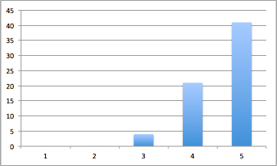
Actives
President
Average: 4.54

Slide 99
Actives
President
more control over meetings
Holly, you are freaking amazing, I know this term have been difficult and you have struggled a little bit, but you have been doing amazing at keeping everything together, despite having excomm position drama. Keep up the good work and make me even prouder to have been your friend
more leadership on other days beside tues/thurs
be more serious
try to be more professional/intimidating

Slide 100
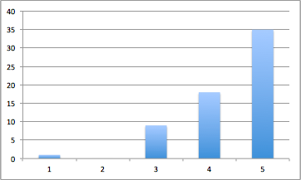
Actives
Admin VPs
Average: 4.35

Slide 101
Actives
Admin VPs
update website
you both are extremely young but you still have done extremely well. I know that you may get a lot of criticism about the website, but in all honesty, it is kind of out of your control. Work on getting more alumni events up. Great job!
like to know progress on new website

Slide 102
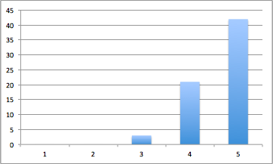
Actives
Membership VP
Average: 4.54

Slide 103
Actives
Membership VP
I'd go back to revelations being 1 by 1 and make the challenges beforehand shorter. Also, don't find out the family first because then it's more obvious who big is before the revealing
Vivian, god you are amazing. I know that you have gone through so much in the past but you have really pulled through. Even through the drama, and the APO bitches you have continued to make membership a position that is sought after and admired.
Revelations was messy and long
make games more organized
more active involvement such as having families on their toes and keep spirit up
fam comp outside of meeting

Slide 104
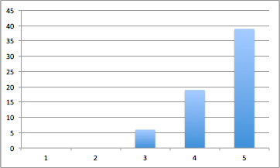
Actives
Service VPs
Average: 4.625

Slide 105
Actives
Service VPs
Put Meals on Wheels back on calendar please and Monday Night Mission because it encourages people to go
you both are working so much harder than the past terms and it is very obvious to everyone. I know that you both are very busy and kinda slipping away from APO so I admire you work even more. Great job guys. More puppies please
more events! and variety!

Slide 106
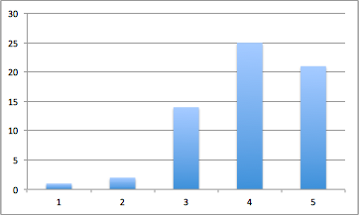
Actives
Pledge Parents
Average: 4.15

Slide 107
Actives
Pledge Parents
more teamwork
Track things faster (or tell PAC to) more sure pledges know interviews etiquette at the beginning
good job with the DPs, set that tone
this pledge class is so spirited and awesome. They look like they're enjoying APO so much so it really reflects well on the PPs
divide work more evenly, less revelations drama and hype. more communication between pledges/actives
when is active appreciation day?
I think you guys need to be more strict with the pledges sometimes. And david really needs to take a bigger role, and be more serious. All I see is Hamilton doing stuff

Slide 108
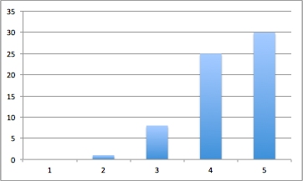
Actives
Finance VPs
Average: 4.46

Slide 109
ACtives
Finance VPs
I really don’t know what you guys do but I am sure that you guys are doing a great job. Make yoursleves more visible, you deserve the credit. And also, thanks for encouraging investing in the chapter ex: projector. Great job
spam masubi fundraiser!
reimburse faster
more fundraising, not just flyering/tv taping!
Chang monetary system, so outdated!
TV Tapings on Saturdays/Sun

Slide 110
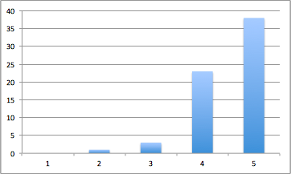
ACtives
Fellowship VPs
Average: 4.47

Slide 111
Actives
Fellowship VPs
thank you guys for being the extremely chill people that you are you both are very welcoming and inviting and make me want to do better
get rid of LGN
more focused on LGN/banquet committee
need more fellowship events on calendar
love secret brother, but thanksgiving one was a little hard to do
track more carefully and more IM Sports

Slide 112
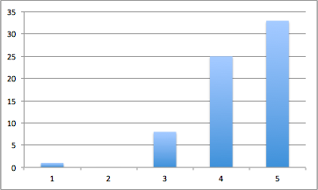
Actives
Historian
Average: 4.375

Slide 113
Actives
Historian
I did not believe in you at all, your presentation was very weak. You have proved me WRONG. You have been doing a wonderful job at completely your job requirement as well as deligating responsibility. You have become a great leader. Good job.
not bad, not good
add weekly recap videos on FB on what was discussed at meeting
more trivia, have a top pic of the week on website!
rehearse more so there won’t be awkward pauses

Slide 114
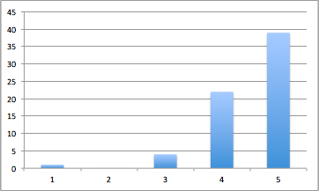
Actives
Sergeant-At-Arms
Average: 4.46

Slide 115
Actives
Sergeant-At-Arms
you are scary as hell, your committee too. Keep up the good work keeping this chapter in line
KISS too serious
stop having your committee do your job, we elected you to serve as SAA up there at meetings
I'd like evaluations to actually be some evaluations in them instead of just a summary so we know what to improve on
more incentive to keep quiet instead of punishment
more approachable

Slide 116
Actives
Interchapter Chair
Average: 4.78

Slide 117
ACtives
Interchapter Chair
I am very glad that you have decided to take his position. Not only do I get to give your beautiful face every meeting, but no one else has the connections with Ics that you do. I hope you continue to do a great job
she rocks my world
our chapter is too rude at IC events
more integration like ice breakers with ICs

Slide 118
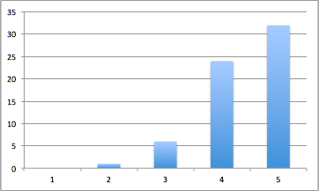
Actives
CAC
Average: 4.65

Slide 119
Actives
CAC
no presence, seems uninterested at meetings
please bring back alum more, otherwise good job
where is the prehealth/premed opportunities?
no resumes
thanks for the career stuff it makes me CACkle with joy
too formal

Slide 120
Actives
Additional comments for Excomm/Chi?
More sports fellowships
everyone do more service
Thank you for keeping this chapter running - I know it's hard
I <3 active missions/achievements - good job MVP
Theme “music” is not that great :(
i like secret brother
I know CAC is busy. TO CHI: please make sure if you schedule with a pledge, please try t not cancel on theme twice. It's very discouraging

Slide 121
Pledges
Additional comments for Excomm?
less chair events. Sometimes the only events you can make it to have chairs. Actually almost all the time. I have to look to chari things and lamost always it doesn't fit with my schedule.
more opening Excomm skits

Slide 122
Pledges
Additional comments for PPs?

Slide 123
Last Announcements

